Slide 1

WQD7001
Data Science : An Overview

Slide 2
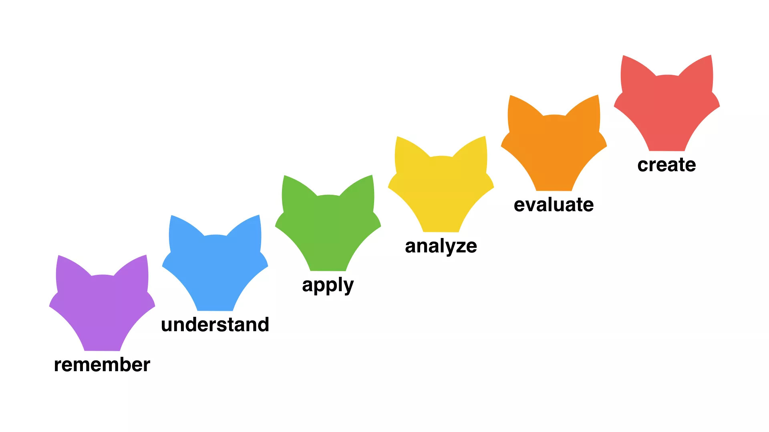
Learning Objective
Demystifying the “buzzword” data science
To describe why data science matters
To construct a definition for data science (the what)
To identify who data scientist are
To determine where and when data science is used / applied
To summarize how data science works
HOT
LOT

Slide 3
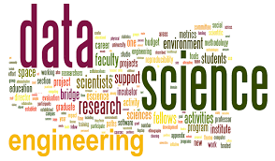
Lecture Outline
1
Why Data Science Matters?
2
What is Data Science?
3
Who is Data Scientist?
4
Where is Data Science Used?
5
When is Data Science Applied?
6
How Data Science Works?

Slide 4

What ONE word that appears in your mind when you hear the term “Data Science”?

Slide 5

Pondering Questions
Q1 - Is Data Science new?
Q2 - Is Data Science the same as Statistics and Analysis?
Q3 - Do you need big data to do Data Science?

Slide 6
Q1 - Is Data Science New?
NOT a new concept!
“For a long time I have thought I was a statistician, interested in inferences from the particular to the general. But as I have watched mathematical statistics evolve, I have had cause to wonder and to doubt…I have come to feel that my central interest is in data analysis, which I take to include, among other things: procedures for analyzing data, techniques for interpreting the results of such procedures, ways of planning the gathering of data to make its analysis easier, more precise or more accurate, and all the machinery and results of (mathematical) statistics which apply to analyzing data.”
Tukey, “The Future of Data Analysis”, 1962
1997, C.F. Jeff Wu gave an inaugural lecture titled simply “Statistics = Data Science?”
2008. The term “data scientist” is often attributed to Jeff Hammerbacher (now, founder and Chief Scientist of Cloudera) and DJ Patil.
Notes:
In this data-intensive universe, data is a critical asset, and data science is the interdisciplinary core that drives new research, education and economy in many diverse areas. Although different definitions and interpretations exist, data science, as a scientific field, develops relevant methodologies, theories, technologies and applications for data, ranging from data capture, creation, representation, storage, search, sharing, privacy, security, modeling, analysis, learning, presentation and visualization, to integration across heterogeneous, interdependent complex resources for real-time decision-making, collaboration, value creation, and decision-support. The field encompasses the larger areas of statistics, data analytics, machine learning, big data management, and other disciplines, including complex systems, communications, social science, decision science, and management science.

Slide 7
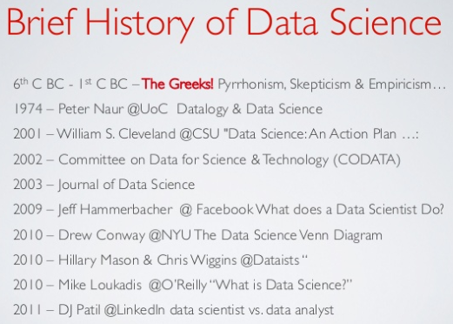
1966

Slide 8
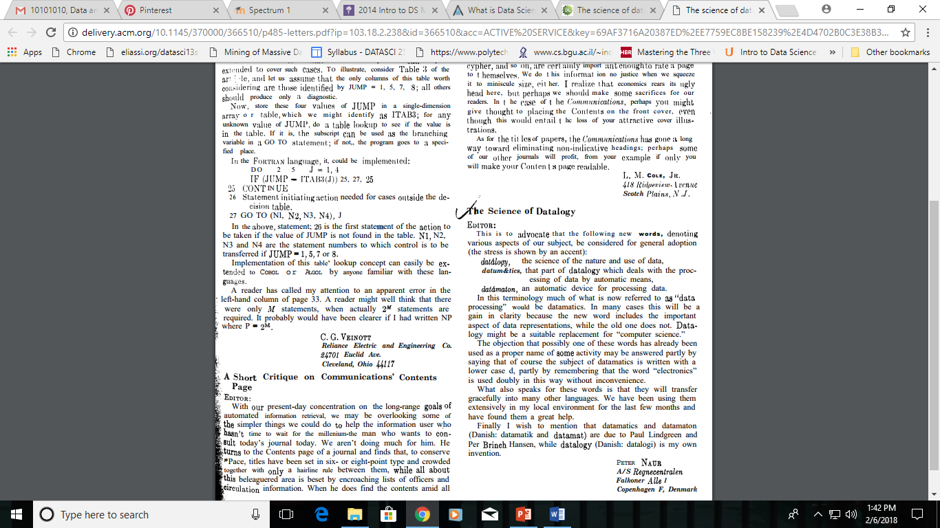
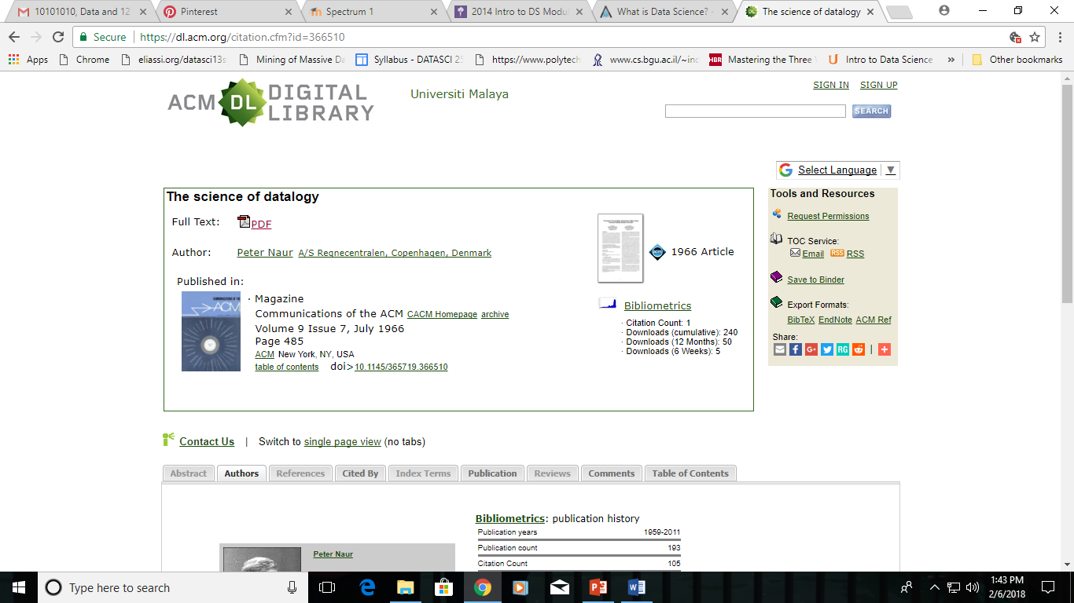

Slide 9
Traditional Approach to Data & Analytics
Modern Approach to Data & Analytics = Data Science
Data
Analytics
Transformation
Data
Data sources & Format
ERP, CRP, Oracle, SAP, MS SQL, etc.
Tables
Files
Data sources & Format
ERP, CRP, Oracle, SAP, MS SQL, etc.
Social (FB, Twitter, Web, LinkedIn)
Streaming
New Data Source & Format
Data Structure
Structured data
ER Model
MDM Model (Multi Dimensional)
Data Structure
Structured data
Unstructured and semi-structured data
Machine data
New Data Architecture
Data Access
SQL
Filters & Aggregate Functions
Business Rules & Formula
Data Access
Parallel Processing
Distributed Computing
In-memory analytics
New Analytics Architecture
Analytics
Reports
Dashboards
Data Analysis
Analytics
Predictive Analytics
Data Mining
Clustering, Segmentation, etc.
New Analytics Techniques
Modernizing existing reporting, data management, data warehousing, analytics and BI solutions
New thinking, new ideas, innovation → new ways of solving problems

Slide 10
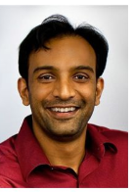

In 2008, Dr DJ Patil and Jeff Hammerbacher, heads of analytics and data at LinkedIn and Facebook respectively, coined the term ‘data science’ to describe the emerging field of study that focused on teasing out the hidden value in the data that was being collected from touchpoints all over the retail and business sectors.
Top data scientist D J Patil's Tips to Build a Career in Data
https://www.youtube.com/watch?v=UuAJMzpoq5E

Slide 11
Q2 - Is it the same as Statistics or Analysis?
“I think data-scientist is a sexed up term for a statistician.... Statistics is a branch of science. Data scientist is slightly redundant in some way and people shouldn’t berate the term statistician.”
Nate Silver, Statistician
Analyzing data is something people have been doing with statistics and related methods for a while.
It’s all about the difference between explaining and predicting.
Data analysis has been generally used as a way of explaining some phenomenon by extracting interesting patterns from individual data sets with well-formulated queries.
Data science, on the other hand, aims to discover and extract actionable knowledge from the data, that is, knowledge that can be used to make decisions and predictions, not just to explain what’s going on.

Slide 12
Statistical analysis is used in order to gain an understanding of a larger population by analyzing the information of a sample. Statistical analysis allows inferences to be drawn about target markets, consumer cohorts and the general population by expanding findings appropriately to predict the behavior and characteristics of the many based on the few.
Data analysis is the process of inspecting, presenting and reporting data in a way that is useful to non-technical people. Because data is next to useless if it can’t be understood by the decision-makers who need to use it, data analysts act as translators between the numbers and figures and the people who need to know about them.
Statistics is part of Data Science.
Analysis is part of Data Science.

Slide 13
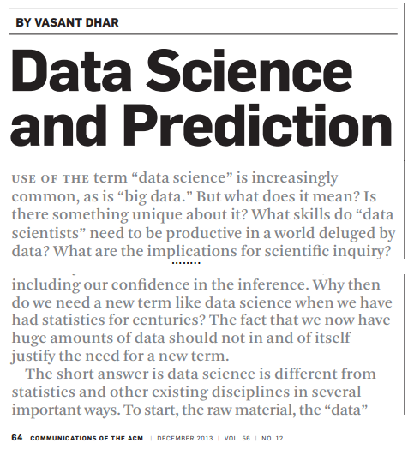
Q3 - Do you need big data to do Data Science?

Slide 14
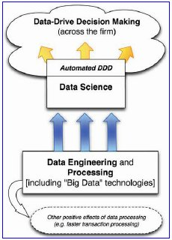
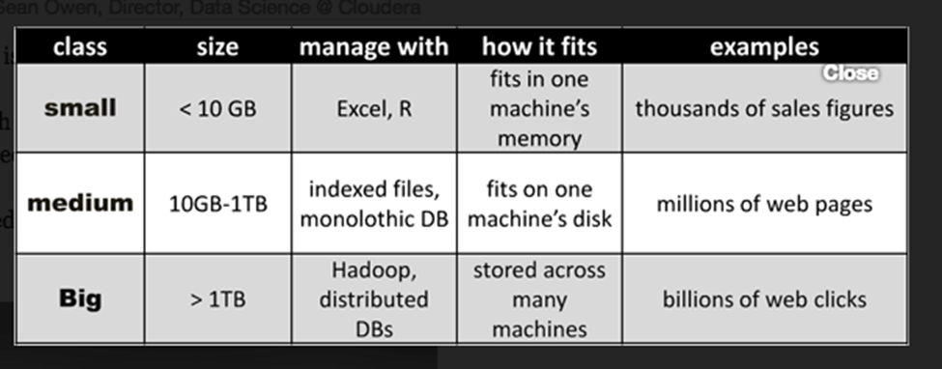
Data Science and Its Relationship to Big Data and Data-Driven Decision Making
The diagram shows data science supporting data-driven
decision making, but also overlapping with it.
This highlights the fact that, increasingly, business decisions are being made automatically by computer systems.
Data engineering and processing are critical to support data-science activities, but they are more general and are useful for much more.
Data-processing technologies are important for many business tasks that do not involve extracting knowledge or data-driven decision making, such as efficient transaction processing, modern web system processing, online advertising campaign management, and others.
Big data - datasets that are too large for traditional data-processing systems and that therefore require new technologies.
Data science in the context of closely related processes in the organization
http://online.liebertpub.com/doi/pdfplus/10.1089/big.2013.1508

Slide 15

Data Scenario
Society is becoming increasingly reliant on data and the tools and methods to acquire and analyze it. Important sources of data that are only starting to be explored come from:
social media,
full-text scientific literature,
video material,
click and interaction patterns,
financial transactions,
customer behavior,
sensors and scientific instrumentation.
We can only fully utilize data if we have the methodologies to store, process and transform it into valuable and accessible information by analysis and modelling.
Being able to fully utilize data will, for example, improve healthcare quality, government efficiency, military effectiveness, steer innovation in business, and forge new scientific discoveries.

Slide 16

Data are Everywhere
When people think of data
Data is much more ubiquitous.
Being actively collected, stashed away in databases on inscrutable corporate servers and funneled into research.
It is the by-product of any and every action, pervading every part of our lives.
Wherever we go, whatever we buy, whatever interests we have, this data is all being collected and remodeled into trends that help advertisers and marketers push their products to the right people.

Slide 17
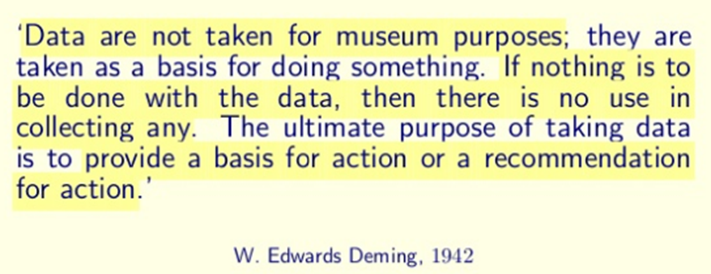

Slide 18
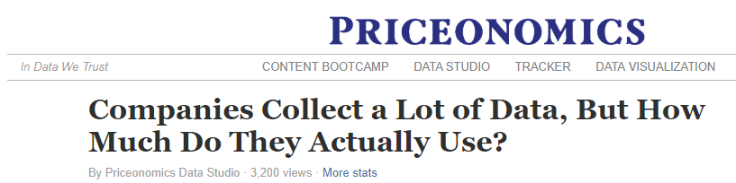
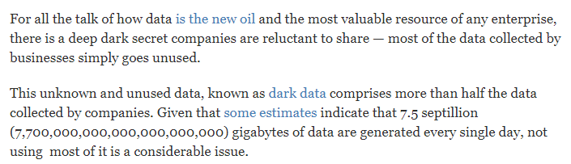
Gartner defines dark data as:
“The information assets organizations collect, process and store during regular business activities, but generally fail to use for other purposes (for example, analytics, business relationships and direct monetizing).
https://priceonomics.com/companies-collect-a-lot-of-data-but-how-much-do/

Slide 19
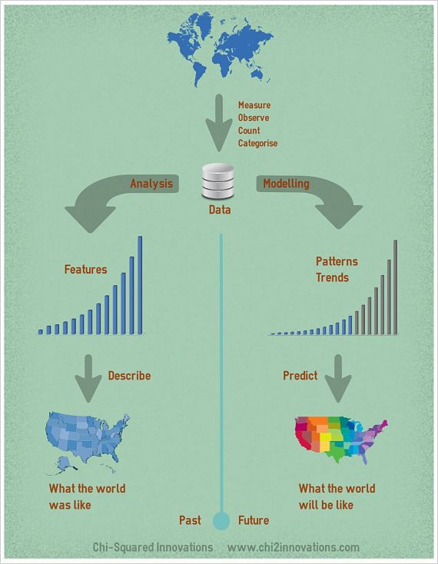
What do we do with the data?
We typically collect data to answer one of 2 questions:
What is the world like?
What is the world going to be like?

Slide 20
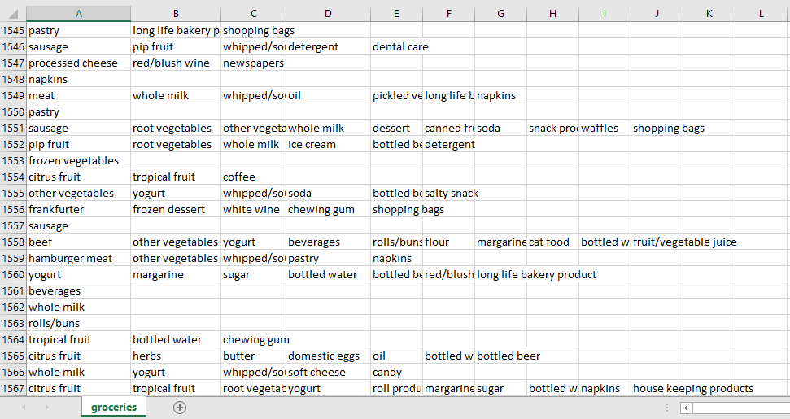
The Groceries Dataset
Groceries Data Set contains: a collection of receipts with each line representing 1 receipt and the items purchased. Each line is called a transaction and each column in a row represents an item.

Slide 21
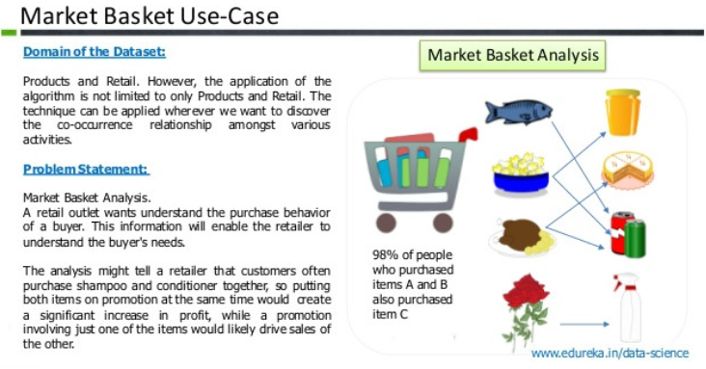

Slide 22
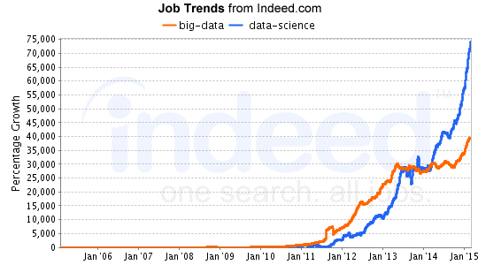
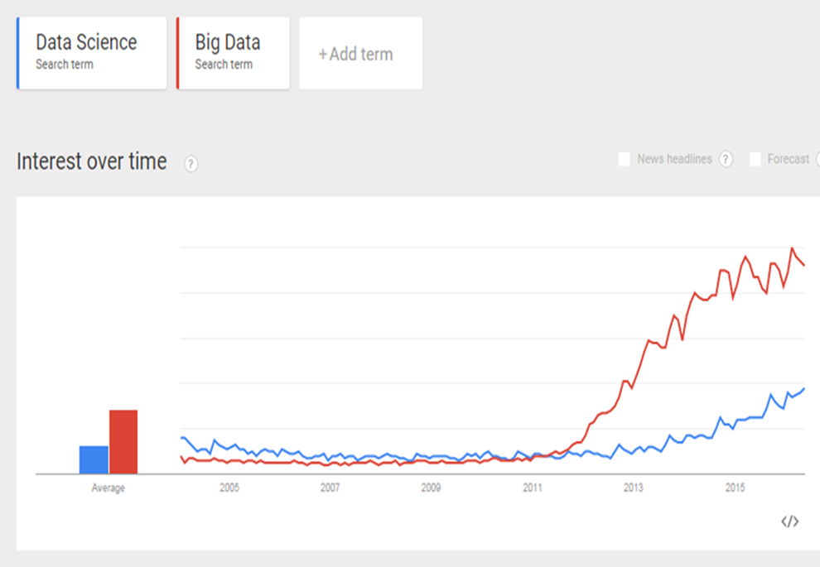
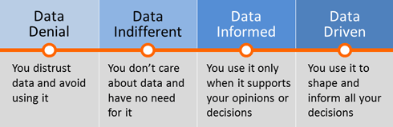

WHY Data Science?
Keyword search.
Emerged as hottest new professions and academic disciplines.
Demand is racing ahead of supply.
Latest Trend – Google Trends
NEED: the future is increasingly complex and difficult to predict.
NEED: we don’t have enough qualified experts, and experts often get it wrong.
RAW MATERIALS: we are generating huge amounts of data at an increasing rate.
ENABLER: new hardware and software tools are emerging.
THEREFORE: Data science is inevitable! We don’t have a choice.
Data-driven decision making
Accuracy
Efficiency

Slide 23
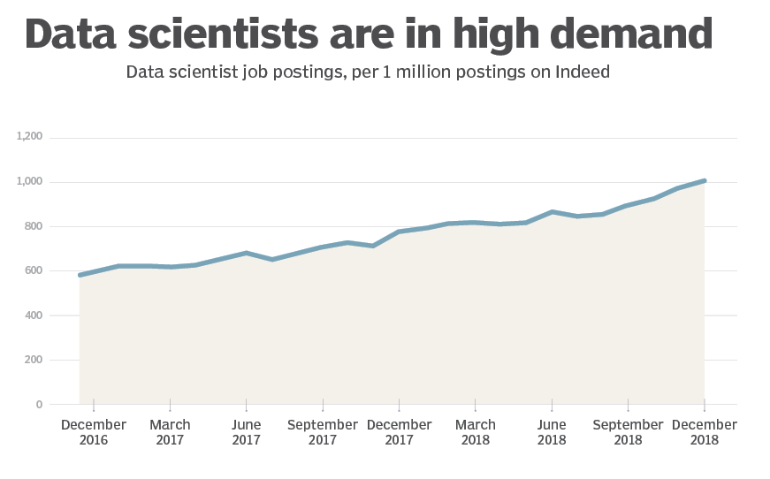
The growth in data scientist job postings on Indeed, from December 2016 to December 2018

Slide 24
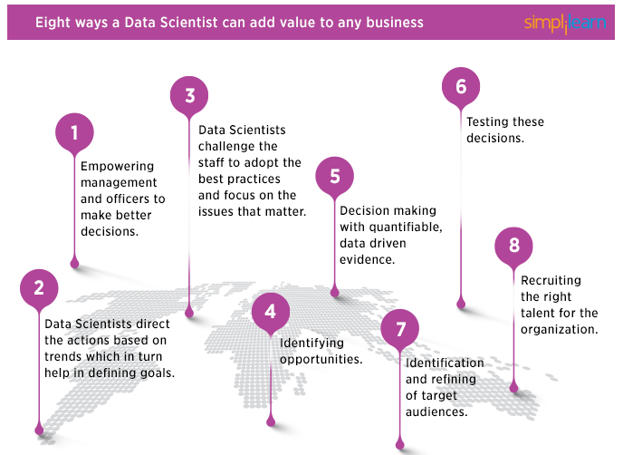
https://www.simplilearn.com/why-and-how-data-science-matters-to-business-article

Slide 25
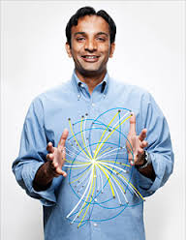

Video
"Data Science: Where are We Going?" - Dr. DJ Patil (12:59 minutes) https://www.youtube.com/watch?v=3_1reLdh5xw
USA first Chief Data Scientist
Former U.S. Chief Data Scientist

Slide 26

Data – The Raw Materials
DATA - Facts and statistics collected together for reference or analysis. Watch the video on “What is Data?” https://www.youtube.com/watch?v=EMHP-q4GEDc
“Data –Information – Knowledge” https://www.youtube.com/watch?v=QsP5WGv0aQc
SCIENCE - A systematic study through observation and experiment. What is Science? https://www.youtube.com/watch?v=hDQ8ggroeE4
How does do science? │ Figuring out what's true https://www.youtube.com/watch?v=3MRHcYtZjFY
DATA SCIENCE - The scientific exploration of data to extract meaning or insight, and the construction of software to utilize such insight in a business context.
Transform data into valuable insights
Transform data into data products
Transform data into interesting stories
DATA

Slide 27
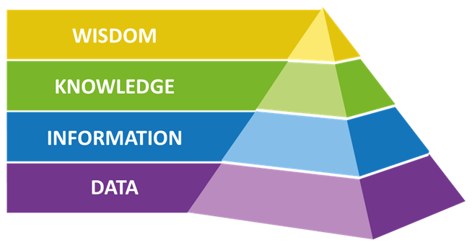
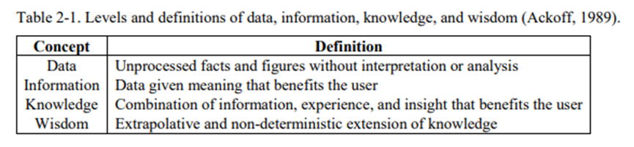

Slide 28
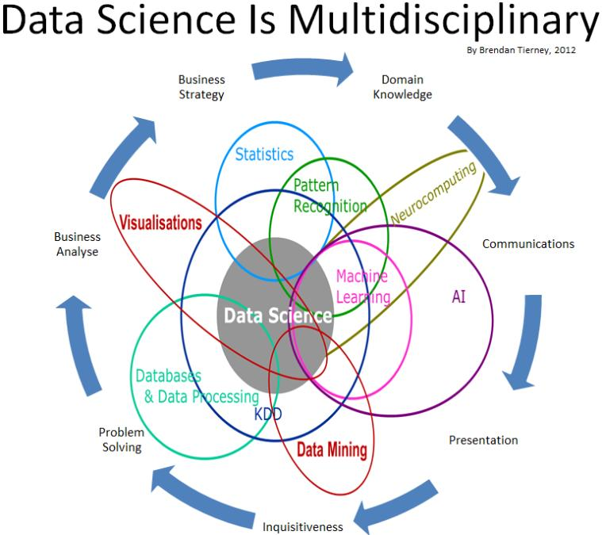
WHAT is Data Science?
"We have lots of data – now what?"
(How can we unlock valuable insight from our data?)
The discipline of drawing useful conclusions from data using computation.
Data science is a broad field that refers:
to the collective processes, theories, concepts, tools and technologies that enable the review, analysis and extraction of valuable knowledge and information from raw data.
It is geared toward helping individuals and organizations make better decisions from stored, consumed and managed data.
Data science is formerly known as datalogy.
Code of conduct for Data Science - http://www.datascienceassn.org/code-of-conduct.html
http://www.forbes.com/sites/gilpress/2013/05/28/a-very-short-history-of-data-science/#2fe9538a69fd
A Very Short History Of Data Science -

Slide 29
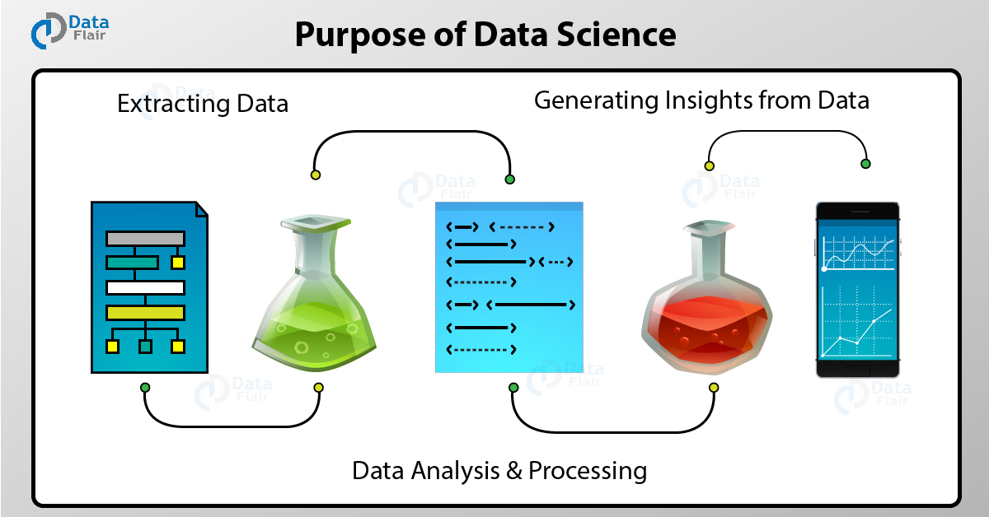

Slide 30

The Science of Data Science
The Art of Data Science
The science to extract hidden values from any data by applying scientific, statistical, mathematical and computing techniques on it.
Discovering what we don’t know from data.
Obtaining predictive, actionable insight from data.
Creating Data Products that have business impact now.
Communicating relevant business stories from data.
Building conﬁdence in decisions that drive business value.
Feature Engineering
Exploratory Data Analysis
Forming and testing hypothesis.
Data science workflow / pipeline.
Running data experiments to validate how certain we are of our interpretations of the results.

Slide 31
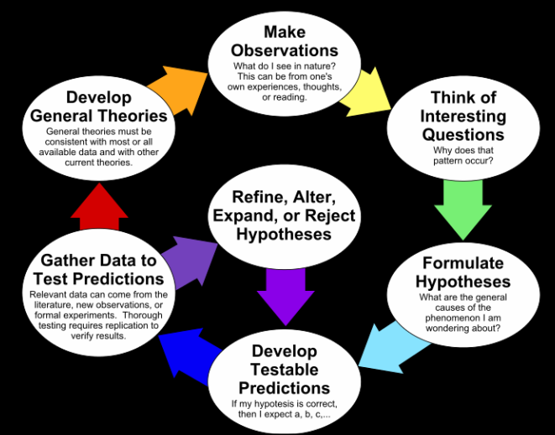
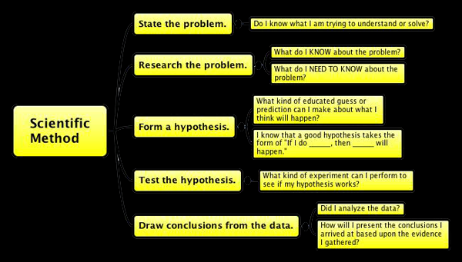
The Science of Data Science
The scientific method: is a set of steps taken to ensure that conclusions are reached sensibly, experiments designed carefully, data is interpreted in accordance with the results of tests, and that procedures can be verified independently.
https://en.wikipedia.org/wiki/Scientific_method

Slide 32
Core Aspects of Effective Data Analysis
In order of difficulty: Descriptive →Exploratory → Inferential → Predictive → Causal → Mechanistic
Descriptive analysis - describe set of data, interpret what you see (census, Google Ngram).
Exploratory analysis - discovering connections (correlation does not = causation).
Inferential analysis - use data conclusions from smaller population for the broader group.
Predictive analysis - use data on one object to predict values for another (if X predicts Y, does not = X cause Y).
Causal analysis - how does changing one variable affect another, using randomized studies, Strong assumptions, golden standard for statistical analysis.
Mechanistic analysis - understand exact changes in variables in other variables, modeled by empirical equations (engineering/physics).
Source: Jeffery Leek
https://github.com/jtleek/dataanalysis/blob/master/week1/007typesOfQuestions/index.md
Dataset Explorer
https://rpubs.com/Salimah/143370
https://salimahm.shinyapps.io/DatasetExplorer/

Slide 33
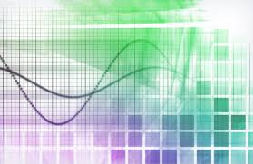
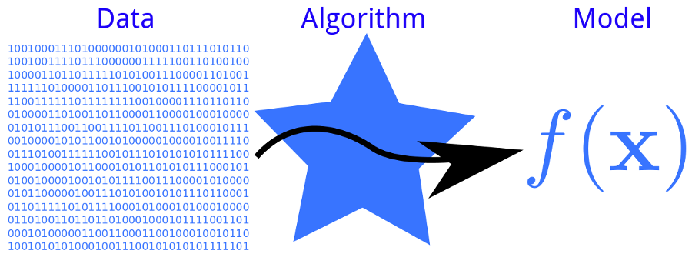
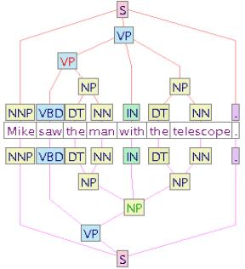
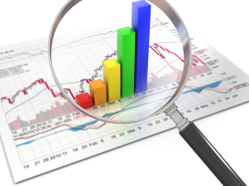
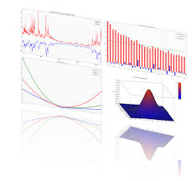
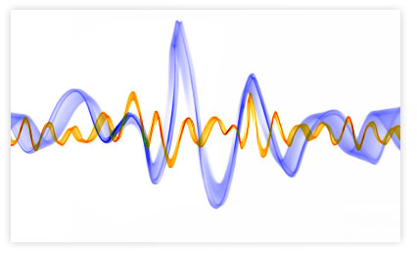
Name of Data Analysis by Data Type
Biostatistics for medical data.
Data Science for data from web analytics.
Machine Learning for data in computer science/
computer vision.
Natural Language Processing for data from texts.
Signal Processing for data from electrical signals.
Business Analytics for data on customers.
Econometrics for economic data.
Source: Jeff Leek’s Data Analysis Coursera Class

Slide 34
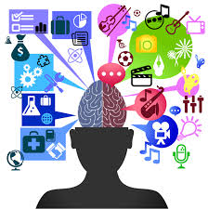
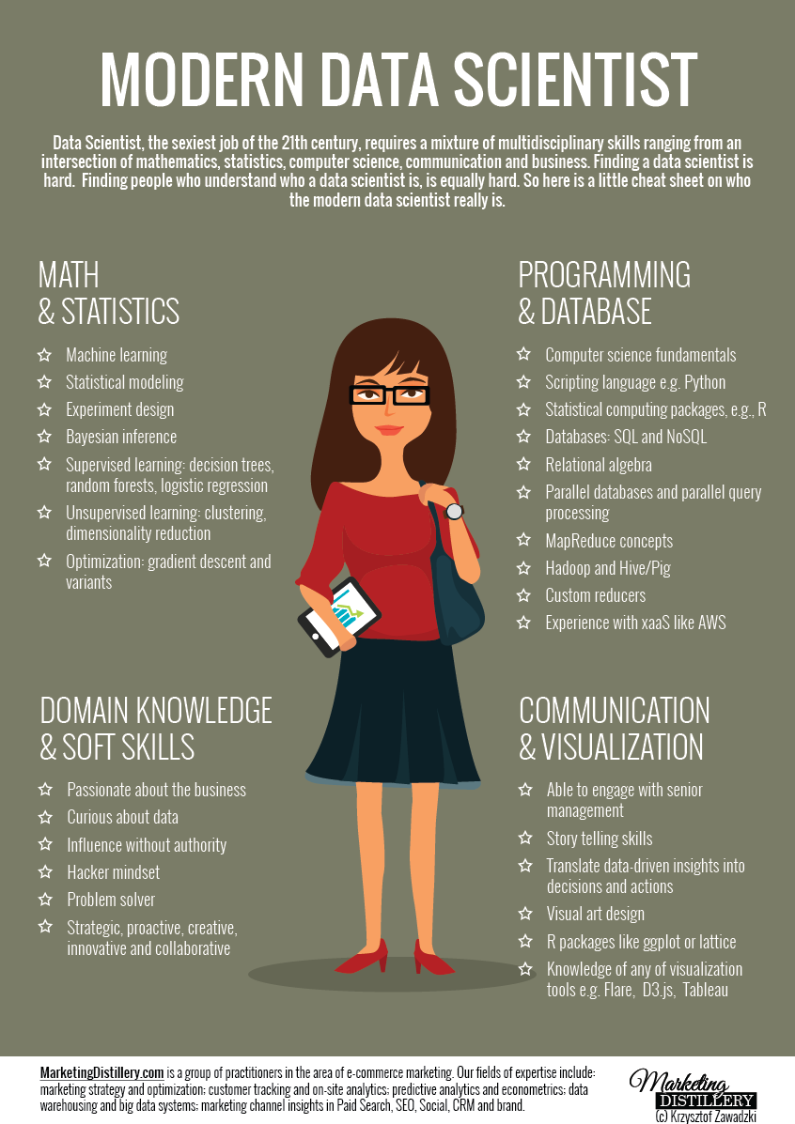
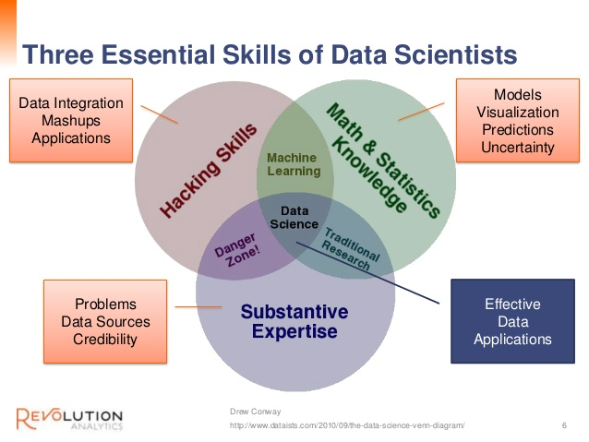
WHO is Involved?

Slide 35
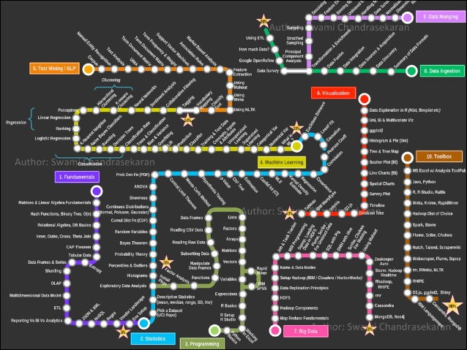
Curriculum via Metromap
Becoming a Data Scientist
Overall plan progressively into the following areas:
Fundamentals
Statistics
Programming
Machine Learning
Text Mining / Natural Language Processing
Data Visualization
Big Data
Data Ingestion
Data Munging
Toolbox
Source: Swami Chandrasekaran
http://nirvacana.com/thoughts/becoming-a-data-scientist/

Slide 36
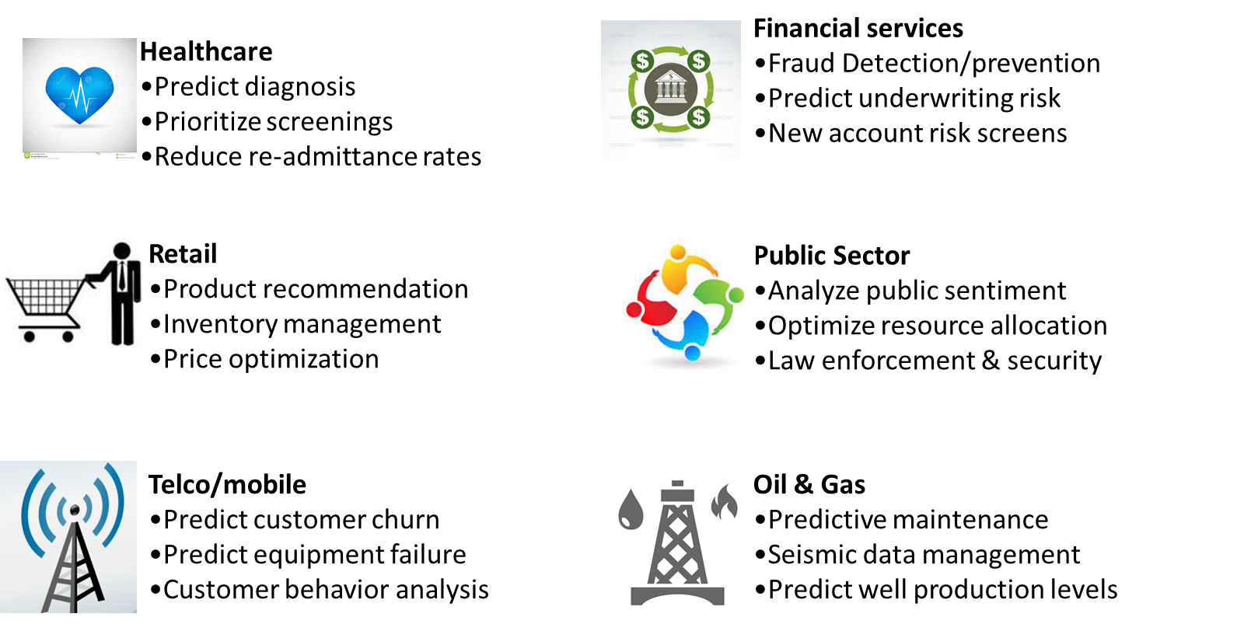
WHERE is Data Science Used?
Domain

Slide 37
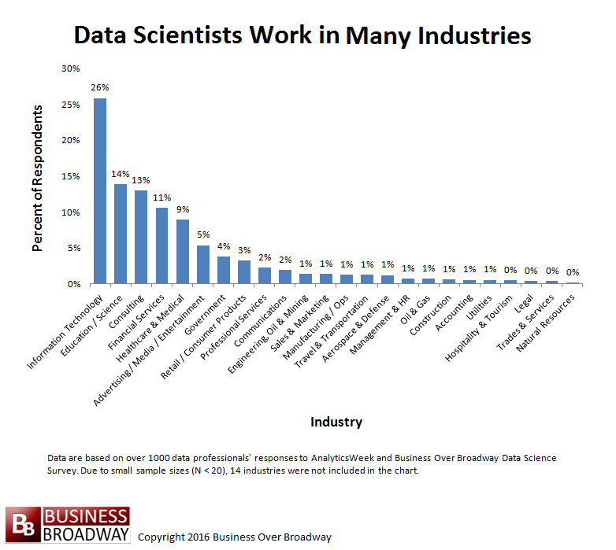

Slide 38
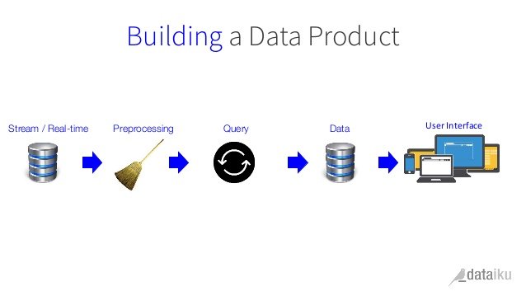
WHEN is Data Science Applied?
Some examples of the outcome of data science i.e. the data products:
Friend Recommendations on Facebook
Music Recommendations on Spotify
Product Recommendations on Amazon
Dynamic Learning and Customized Assessments at Knewton Academy
Trading Algorithms, Models and Credit Ratings in Finance.
New government policies based on data.
Predicting Flu Trends in Health
Targeted Advertising
Applications
SOURCE: http://www.analyticsvidhya.com/blog/2015/09/applications-data-science/

Slide 39
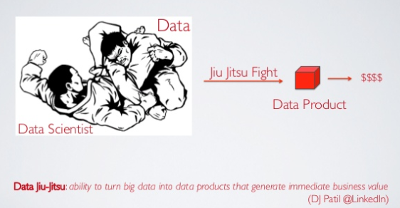
Data Jiu-Jitsu

Slide 40
Amazon recommendations, marketing campaigns, Uber, Siri, price comparison sites, gaming and image recognition, are all powered, to varying degrees, by data science.

Slide 41
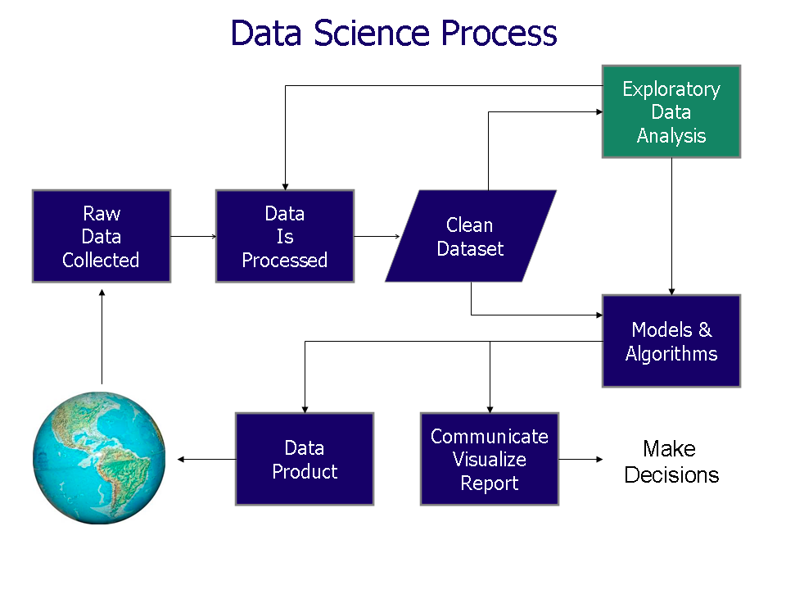
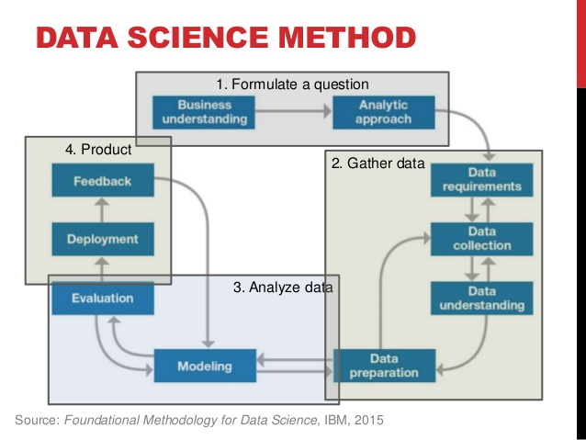
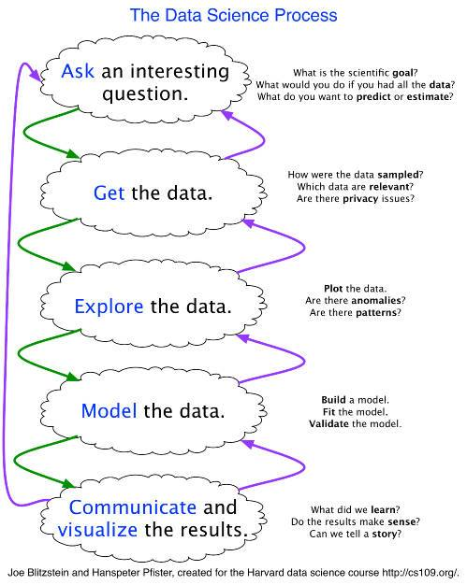
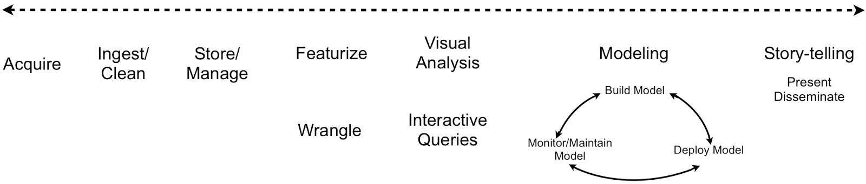
HOW Data Science Works?
Data science is a multi-step process and each step in this process requires a diverse set of skills and technologies.
Data Science Workflow
See also:
https://www.edureka.co/blog/what-is-data-science/

Slide 42
Data Science Methodology
Problem Formulation – First, identify the problem to be solved. This step is easily overlooked. However, many dollars and hours have been spent solving the wrong problems.
Obtain The Data – Next, collect new data and/or gather the data that already exists. In almost all cases, this data will need to be transformed and cleansed. It is important to note that this stage does not always involve big data or a data lake.
Analysis – This is the part of the process where insight is to be extracted from the data. Commonly, this step will involve creating and optimizing statistical/machine learning models for prediction, but that is not always necessary. Sometimes, the analysis only contains graphs, charts, and basic descriptions of the data.
Data Product – The end goal of data science is a data product. The insight from the Analysis phase needs to be conveyed to an end user. The data product might be as simple as a slideshow; more commonly it is a website dashboard, a message, an alert, or a recommendation.

Slide 43
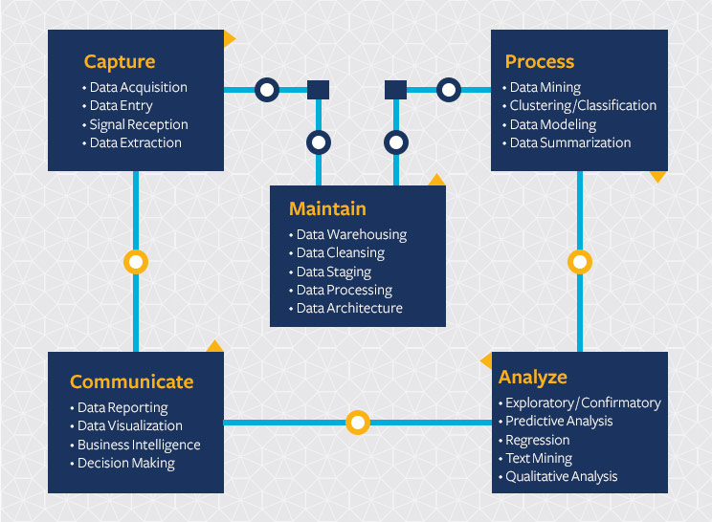
The Data Science Life Cycle
https://datascience.berkeley.edu/about/what-is-data-science/

Slide 44
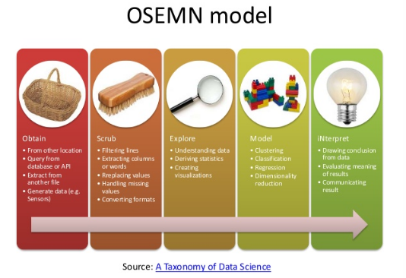

Slide 45
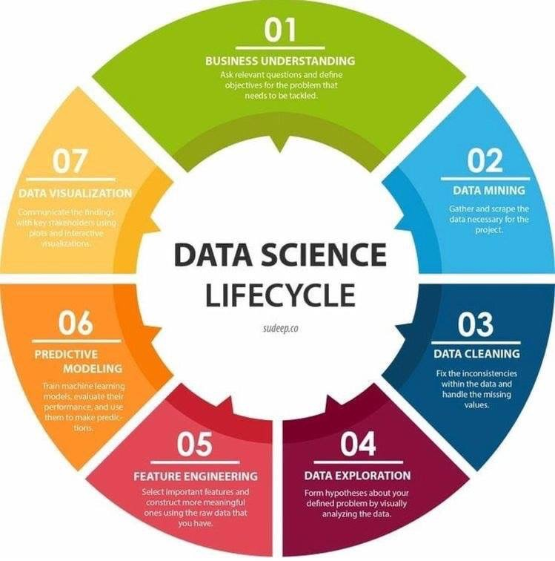

Slide 46
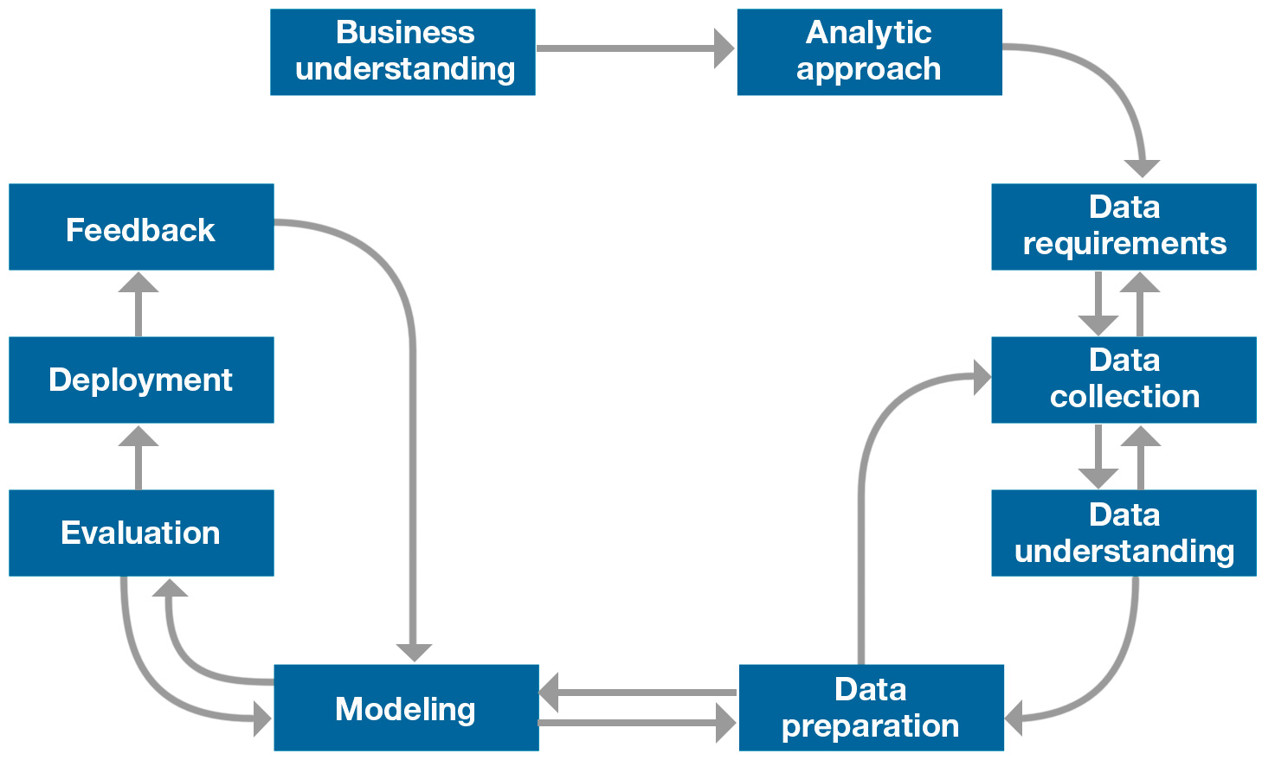
Foundational Methodology for Data Science
A methodology is a general strategy that guides the processes and activities within a given domain.
Methodology does not depend on particular technologies or tools, nor is it a set of techniques or recipes.
Rather, a methodology provides the data scientist with a framework for how to proceed with whatever methods, processes and heuristics will be used to obtain answers or results.
CRISP-DM - Cross Industry Standard Process for Data Mining

Slide 47
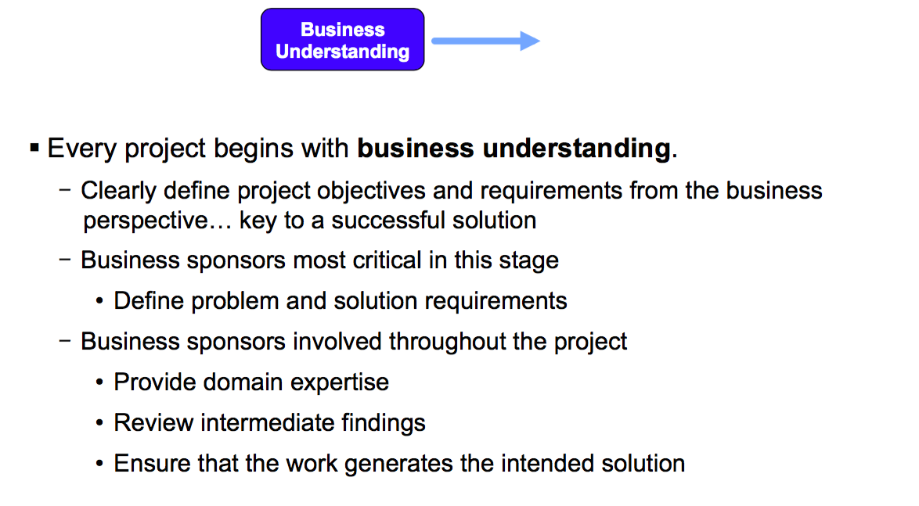
Don’t ignore domain knowledge. Do consult a subject matter expert
http://101.datascience.community/2016/04/25/dos-and-donts-of-data-science/

Slide 48

Don’t Start with the Data! Do Start with a Good Question.

Slide 49

Don’t brag about the size of your data. Do collect relevant data.
Don’t publish a table of numbers Do create informative charts
Don’t use just your own data Do enhance your analysis with open data

Slide 50


Slide 51


Slide 52

Don’t always build your own tools Do use lots of open source tools

Slide 53

Don’t think one person can do it all Do build a well-rounded team.
Don’t only use one tool. Do use the best tool for the job
Don’t keep all your findings to yourself. Do share your analysis and results with the world!

Slide 54






The Importance of Visualization
Infographics - a great way to convey information about data.

Slide 55

Case Study: Target
Source: http://www.forbes.com/sites/kashmirhill/2012/02/16/how-target-figured-out-a-teen-girl-waspregnant-before-her-father-did/

Slide 56





Resources
The Open-Source Data Science Masters - http://datasciencemasters.org/
Data Science Certificate - https://www.coursera.org/specializations/jhu-data-science
Data Science Courses – bigdatauniversity.com
Data Science Association – www.datascienceassn.org
JOURNAL TITLE
EJP Data Science
CODATA Data Science Journal
Journal of Data Science Online
Big Data Journal
JDS (focuses heavily on the applications of data.)
GigaScience (focuses on life and biomedical science)

Slide 57


Slide 58

Conclusion
Data science is a growth area. (The number of data scientists has doubled over the last 4 years)
The future belongs to the companies and people that turn data into products. (The Information Technology and Services industry employs the largest number of data scientists.)
Top skills (The top five skills listed by data scientists are: Data Analysis, R, Python, Data Mining, and Machine Learning)
Education level (Over 79% of data scientists that list their education have earned a graduate degree, and 38% have earned a PhD.)
Source:
https://rjmetrics.com/resources/reports/the-state-of-data-science/

Slide 59


Data science for the environment | Dan Hammer | TEDxBerkeley
https://www.youtube.com/watch?v=ph439t-kTIE

Slide 60


Own definition of data science based on own understanding
Identify famous data scientist
List domains of DS applications and examples of data products.
Rationale why data science matters today
Provide methodology, process, lifecycle, or workflow for data science

Slide 61


